Slide 1
BANA 4080 Homework 5 Review
Mike Platt
plattm@ucmail.uc.edu

Slide 2
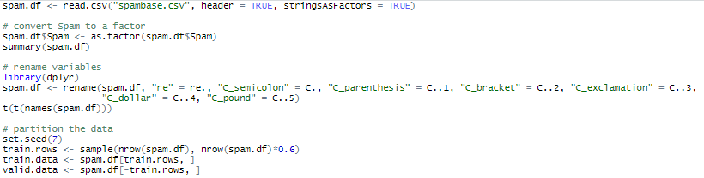
Pre-Processing
Converted Spam to a factor.
Renamed the predictors containing special characters in their names.
Partitioned the data, using 60% of the records for training data and the remaining 40% for validation.

Slide 3

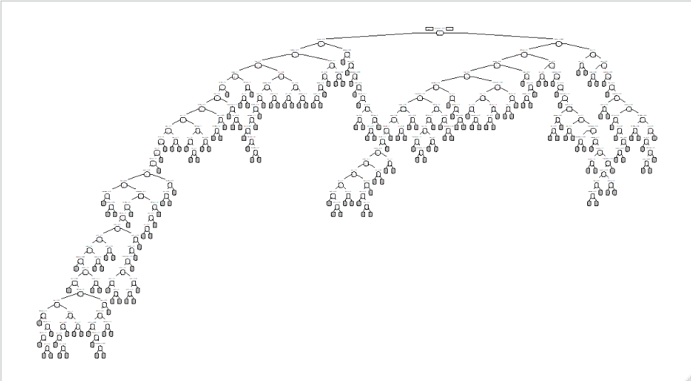
Full Tree
This tree has 182 leaves. In addition to being illegible, it likely overfits the training data.

Slide 4
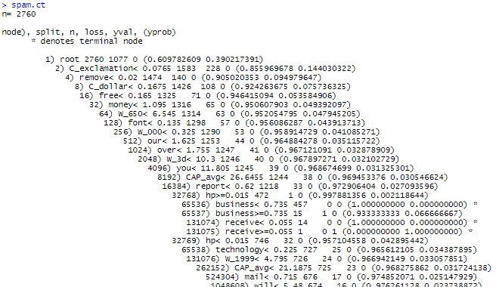
Full Tree Rules (Partial)

Slide 5
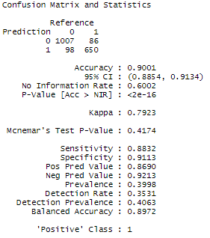
Classification Performance of the Full Tree
Overall, the full tree classifies 90% of the records correctly.
It correctly classifies 88.3% of the spam emails and 91.1% of the non-spam emails.
86.9% of predicted spam emails are actually spam.
39.98% of the emails in the validation data set are spam.

Slide 6
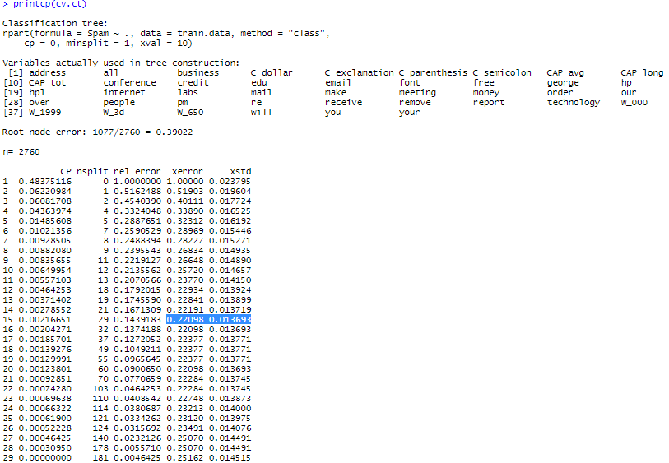
Pruning the Tree
best pruned tree – smallest tree with xerror less than 0.234673
minimum error tree
xerror + xstd
=0.22098+0.013693
=0.234673
We will use cp=0.00464253 to define the tree going forward.

Slide 7
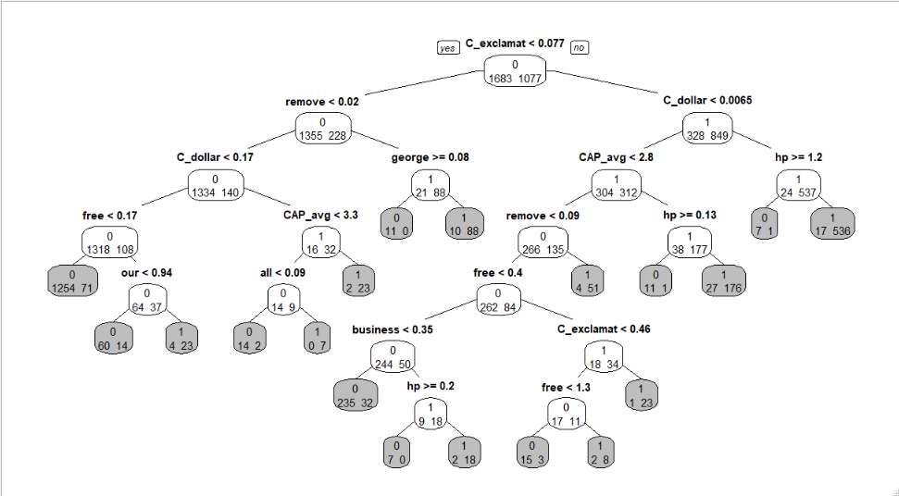
Best Pruned Tree

Slide 8
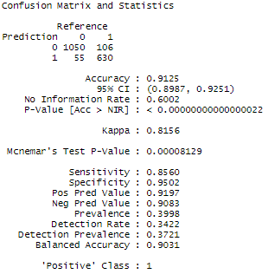
Classification Performance of the Best Pruned Tree
Overall, the best pruned tree classifies 91.25% of the records correctly (compared to 90% for the full tree).
It correctly classifies 85.6% (vs. 88.3%) of the spam emails and 95% (vs. 91.1%) of the non-spam emails.
92% (vs. 86.9%) of predicted spam emails are actually spam.
The best pruned tree identifies good emails better than the full tree but does miss more spam.

Slide 9
Classifying a New Record
We predict that this email is spam.

Slide 10
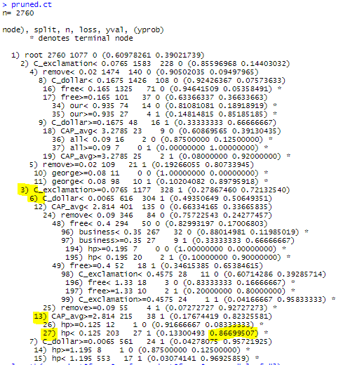

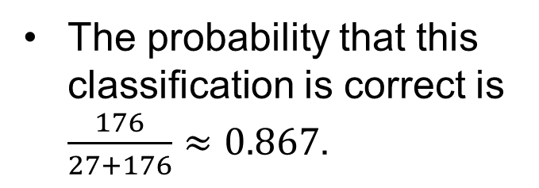
Probability of Correct Classification
The probability that this classification is correct is $\frac{176}{27+176}≈0.867$.

Slide 11
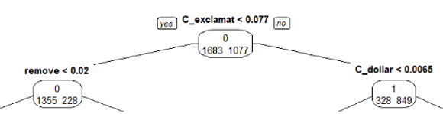
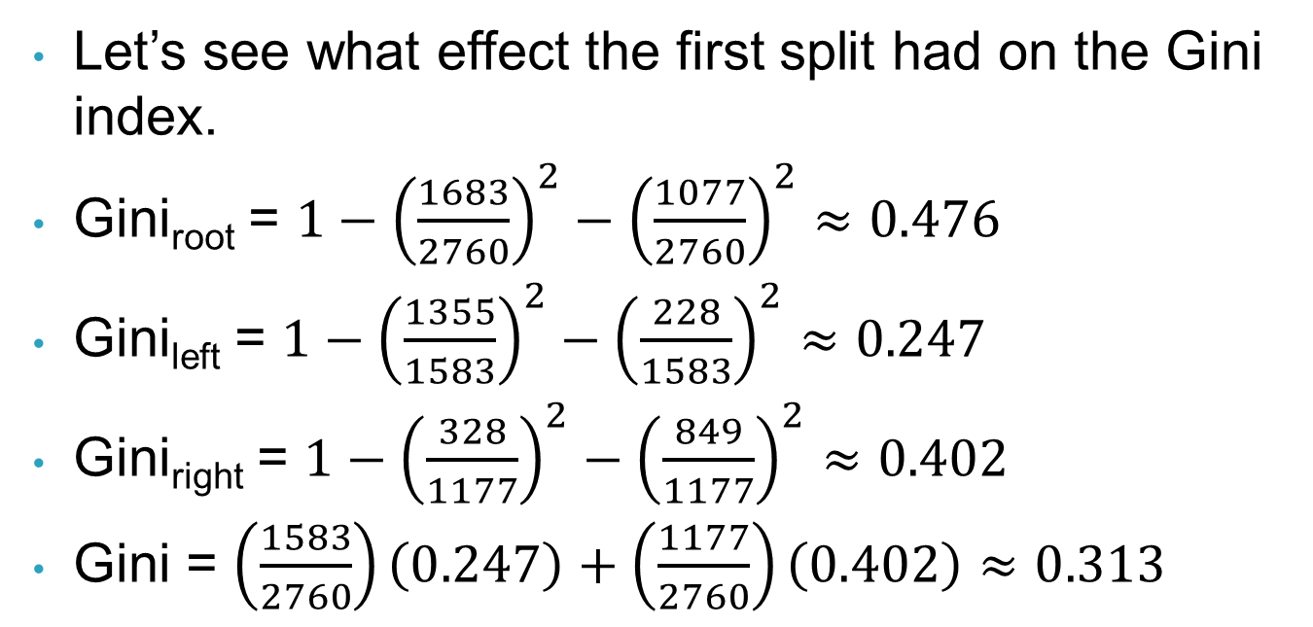
A Note on Gini Index
Let’s see what effect the first split had on the Gini index.
Gini_{root} = $1−{\left(\frac{1683}{2760}\right)}^{2}−{\left(\frac{1077}{2760}\right)}^{2}≈0.476$
Gini_{left} = $1−{\left(\frac{1355}{1583}\right)}^{2}−{\left(\frac{228}{1583}\right)}^{2}≈0.247$
Gini_{right} = $1−{\left(\frac{328}{1177}\right)}^{2}−{\left(\frac{849}{1177}\right)}^{2}≈0.402$
Gini = $\left(\frac{1583}{2760}\right)\left(0.247\right)+\left(\frac{1177}{2760}\right)\left(0.402\right)≈0.313$

Slide 12

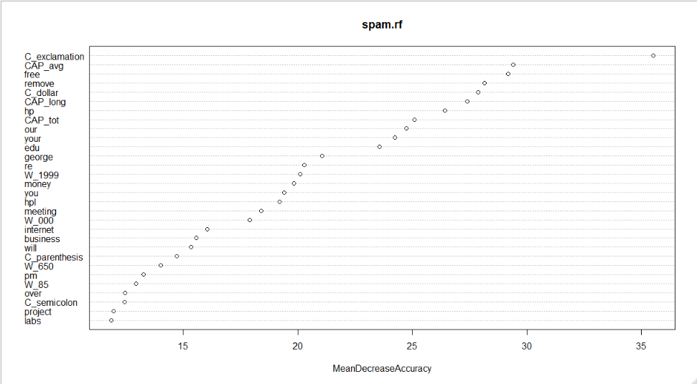
Random Forest
C! is definitely the most important predictor in determining spam.
Also important (but to a lesser extent) were CAP_avg and free, followed by remove, C$, and CAP_long.

Slide 13
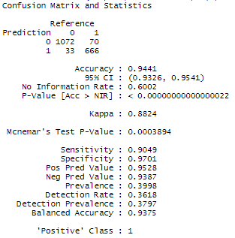
Classification Performance of the Random Forest
Overall, the random forest classifies 94.4% of the records correctly (compared to 91.25% for the best pruned tree).
It correctly classifies 90.5% (vs. 85.6%) of the spam emails and 97% (vs. 91.1%) of the non-spam emails.
95.3% (vs. 92%) of predicted spam emails are actually spam.
The random forest performs much better than the both the full tree and the best pruned tree.

Slide 14
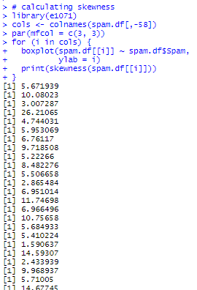
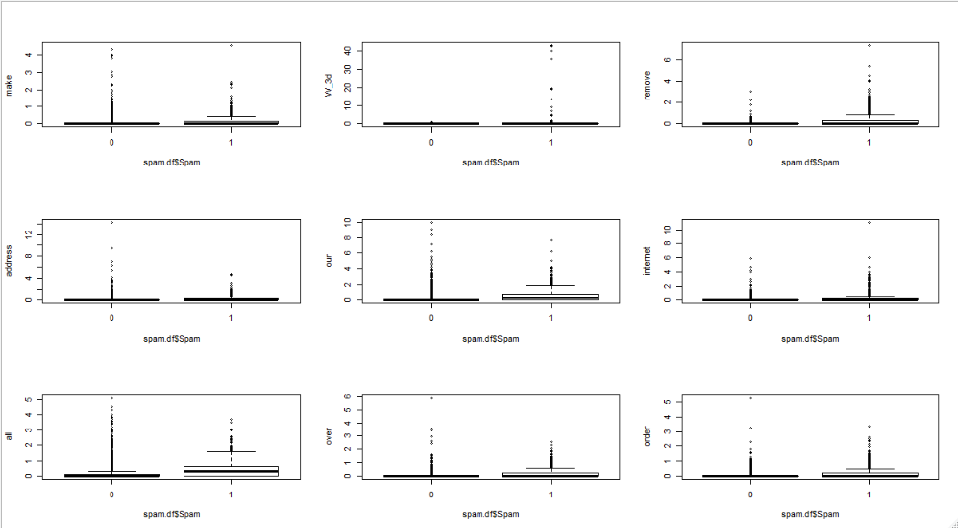
Pre-Processing for Neural Nets
Calculated the skewness of all numerical variables and found that every single predictor is highly skewed.
Will need to apply a log transformation to all 57 predictors.
partial
output

Slide 15

Pre-Processing for Neural Nets
Used a for loop to apply log transformation to all predictors

Slide 16
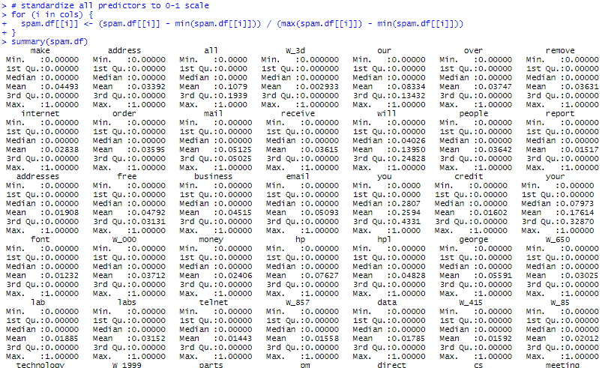
Pre-Processing for Neural Nets
Normalized all predictors to a 0-1 scale.

Slide 17

Pre-Processing for Neural Nets
Partitioned the newly processed data.

Slide 18
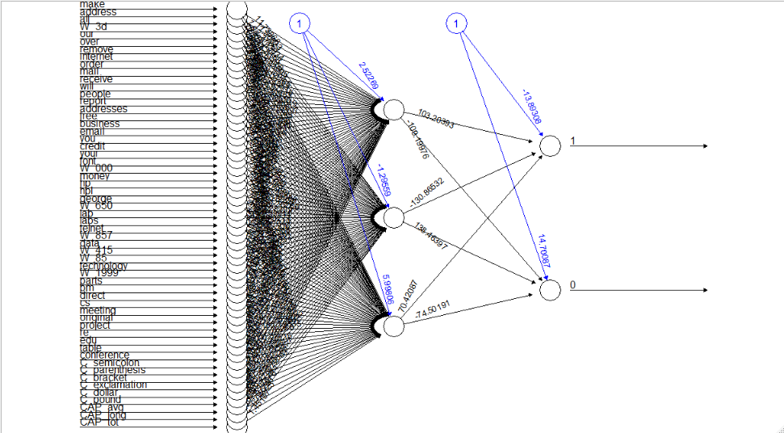
Neural Net – 1 Hidden Layer with 3 Nodes

Slide 19
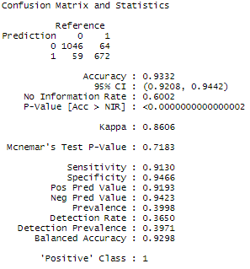
Classification Performance of the 1st Neural Net (1 hidden layer, 3 nodes)
Overall, the 1st neural net classifies 93.3% of the records correctly.
It correctly classifies 91.3% of the spam emails and 94.7% of the non-spam emails.
91.9% of predicted spam emails are actually spam.

Slide 20
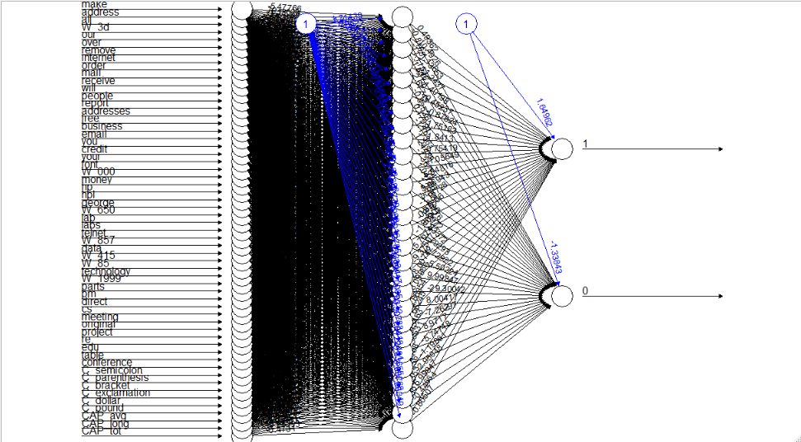
Neural Net – 1 Hidden Layer with 28 Nodes

Slide 21
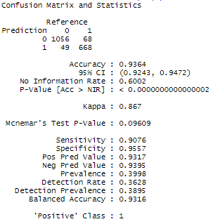
Classification Performance of the 2nd Neural Net (1 hidden layer, 28 nodes)
Overall, the 2nd neural net classifies 93.6% of the records correctly.
It correctly classifies 90.8% of the spam emails and 95.6% of the non-spam emails.
93.2% of predicted spam emails are actually spam.

Slide 22
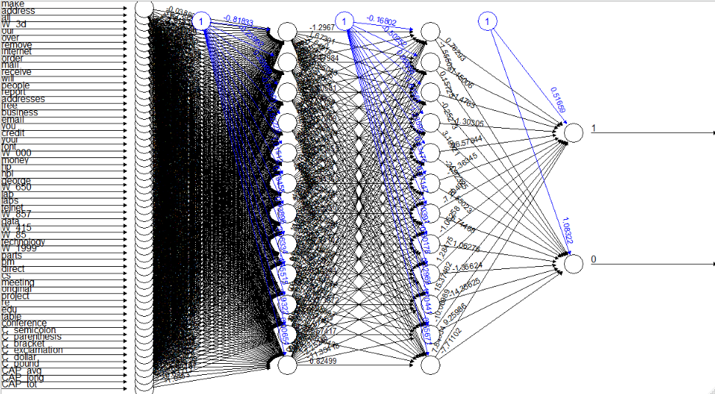
Neural Net – 2 Hidden Layer with 12 Nodes Each

Slide 23
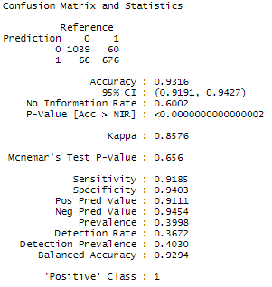
Classification Performance of the 3rd Neural Net (2 hidden layers, 12 nodes each)
Overall, the 3rd neural net classifies 93.2% of the records correctly.
It correctly classifies 91.9% of the spam emails and 94% of the non-spam emails.
91.1% of predicted spam emails are actually spam.

Slide 24
Summary
Model | Accuracy | Sensitivity | Specificity | Precision
Full tree | 0.9001 | 0.8832 | 0.9113 | 0.8690
Best pruned tree | 0.9125 | 0.8560 | 0.9502 | 0.9197
Random forest | 0.9441 | 0.9049 | 0.9701 | 0.9528
Neural net (1 hidden layer, 3 nodes) | 0.9332 | 0.9130 | 0.9466 | 0.9193
Neural net (1 hidden layer, 28 nodes) | 0.9364 | 0.9076 | 0.9557 | 0.9317
Neural net (2 hidden layers, 12 nodes each) | 0.9316 | 0.9185 | 0.9403 | 0.9111
The random forest has the highest overall accuracy, specificity, and precision (by a wide margin).
The neural net model with two hidden layers of three nodes each has the highest sensitivity.
I would likely use the random forest model to classify emails, due to both its strong performance and its greater interpretability.

